Slide 1
ItP171 it fundamentals AND PROJECT
Networking

Slide 2
Networks
A network is a collection of computers and devices connected together via communications devices and transmission media
Advantages of a network include:
Facilitating communications
Sharing hardware
Sharing data and information
Sharing software
Transferring funds

Slide 3
World Wide Web Is…
A collection of networks and communication devices, internal and external, working together
To ensure information is sent/receive:
Without failure
Secured
Intended
http://youtu.be/yaWpqhdooYU
http://youtu.be/LVlT4sX6uVs

Slide 4
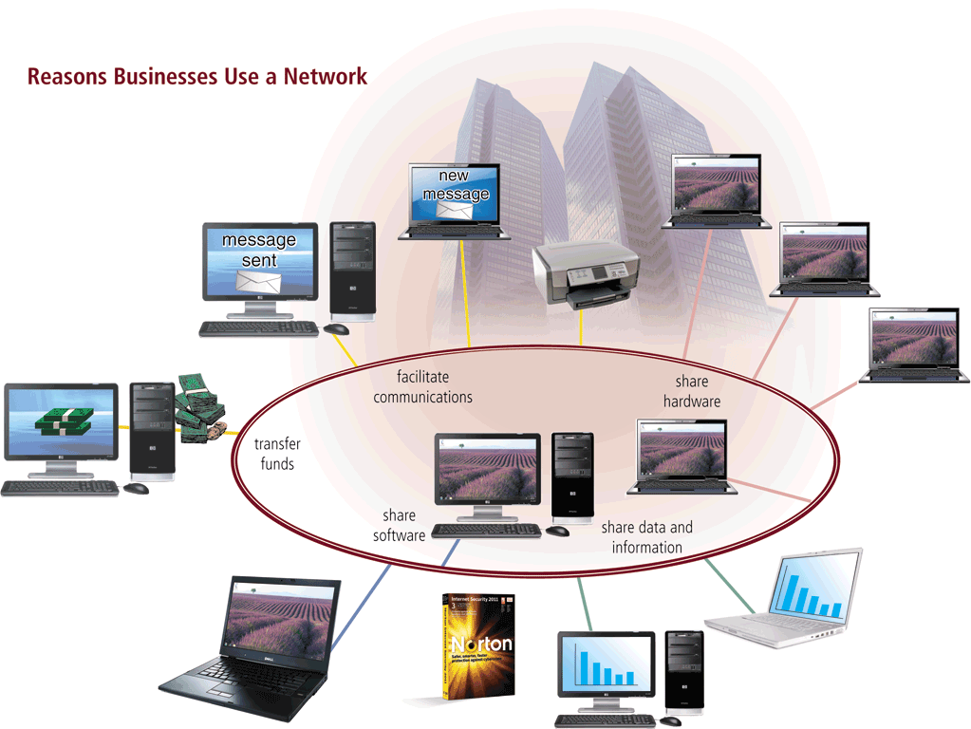
Networks

Slide 5
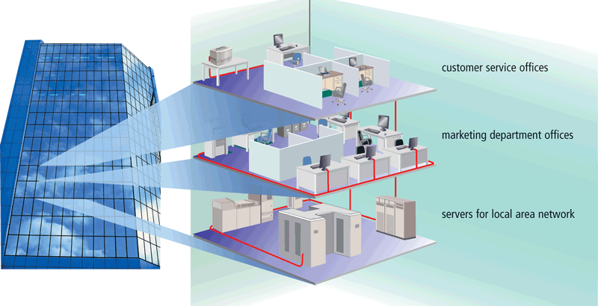
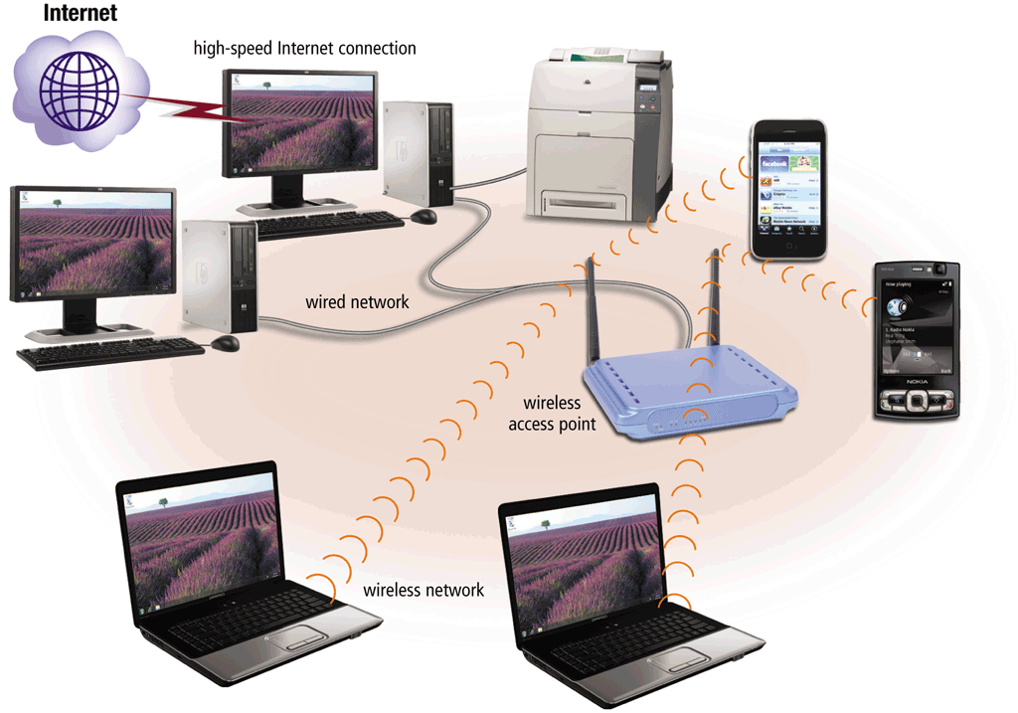
Networks
A local area network (LAN) is a network that connects computers and devices in a limited geographical area
A wireless LAN (WLAN) is a LAN that uses no physical wires

Slide 6
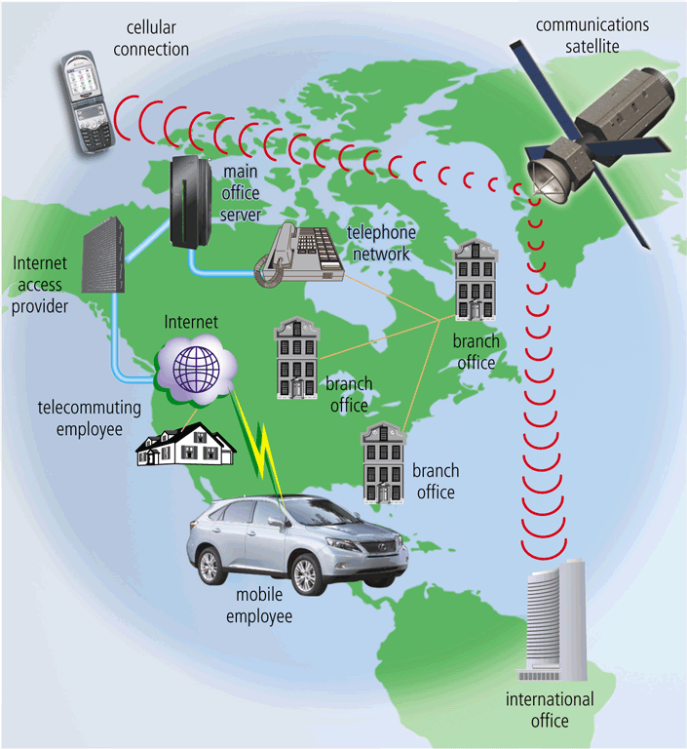
Networks
A metropolitan area network (MAN) connects LANs in a metropolitan area
A wide area network (WAN) is a network that covers a large geographical area

Slide 7
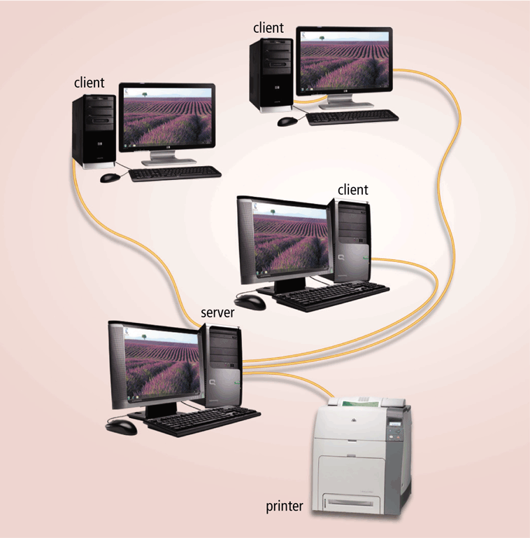
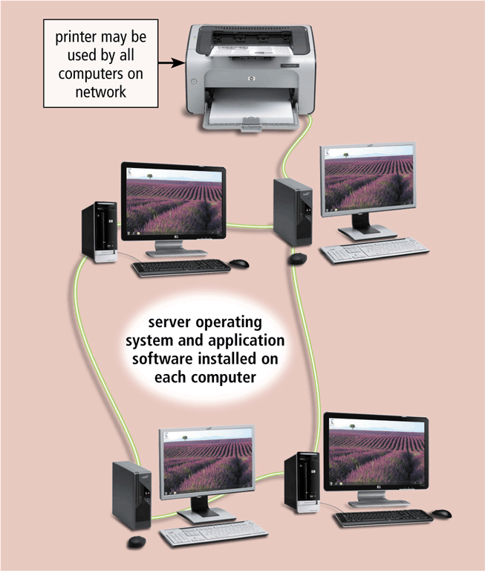
Networks
The design of computers, devices, and media on a network is sometimes called the network architecture
Client/server network
Peer-to-peer network

Slide 8
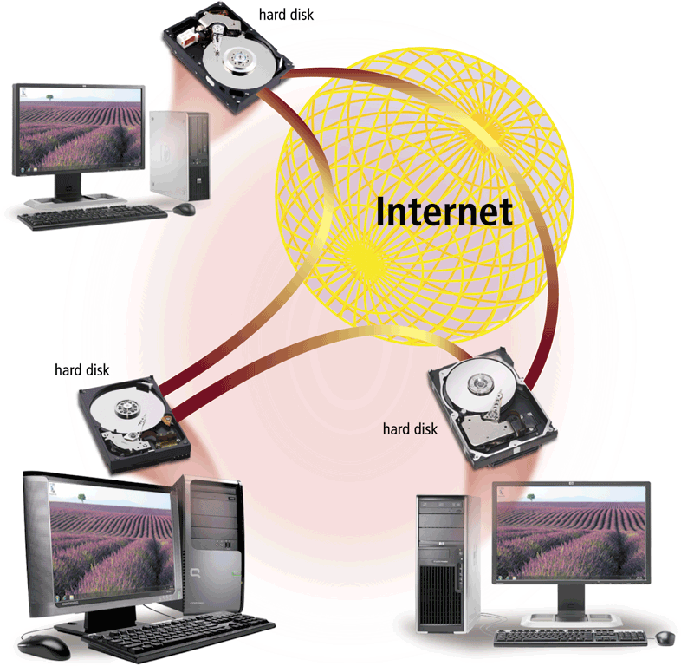
Networks
P2P describes an Internet network on which users access each other’s hard disks and exchange files directly over the Internet

Slide 9
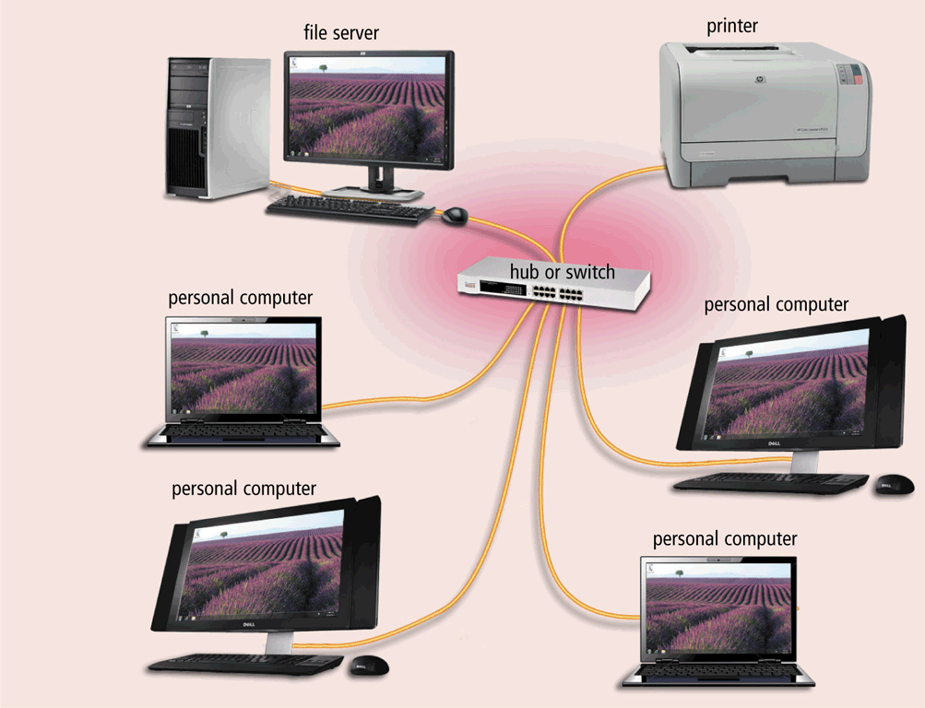
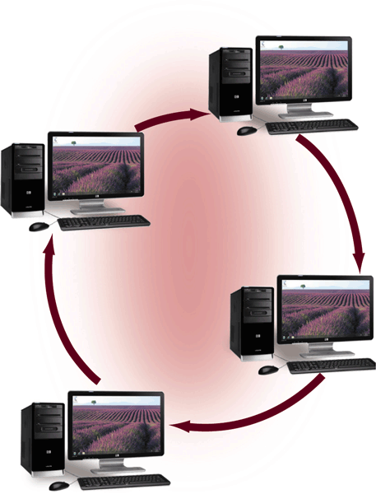
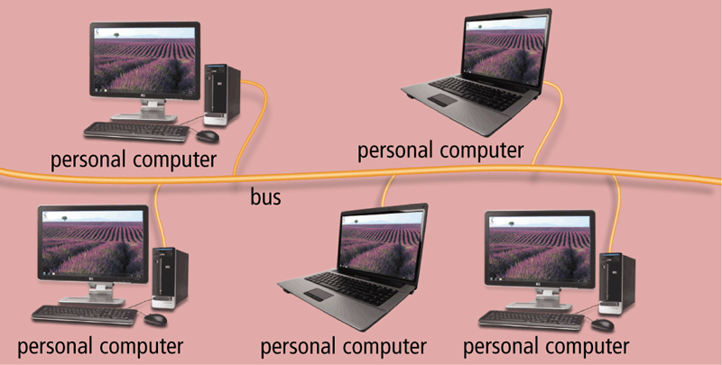
Networks
A network topology refers to the layout of the computers and devices in a communications network
Star network
Bus network
Ring network

Slide 10
Network Communications Standards
Ethernet
Token ring
TCP/IP
Wi-Fi
Bluetooth
UWB
IrDA
RFID
WiMAX
WAP
Notes:
WiFi

Slide 11

WiFi
What does WiFi means?
the use of wireless LANs to the home market to transfer audio and video.
WIFI means “Wireless Fidelity” (WRONG!!)

Slide 12
Network Communications Standards
Ethernet is a network standard that specifies no computer controls when data can be transmitted
The token ring standard specifies that computers and devices on the network share or pass a special signal (token)
TCP/IP is a network standard that defines how messages are routed from one end of a network to another
Page 478

Slide 13
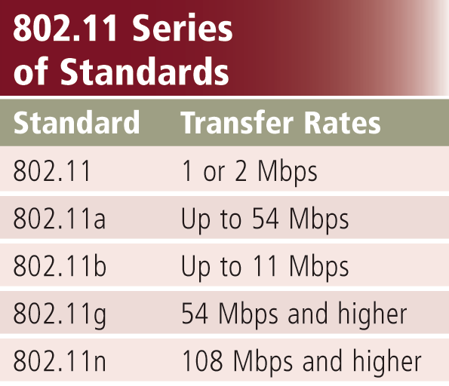
Network Communications Standards
Wi-Fi identifies any network based on the 802.11 standard that facilitates wireless communication
Sometimes referred to as wireless Ethernet

Slide 14
Network Communications Standards
Bluetooth defines how two Bluetooth devices use short-range radio waves to transmit data
UWB (ultra-wideband) specifies how two UWB devices use short-range radio waves to communicate at high speeds
IrDA transmits data wirelessly via infrared (IR) light waves
RFID uses radio signals to communicate with a tag placed in or attached to an object, animal, or person

Slide 15
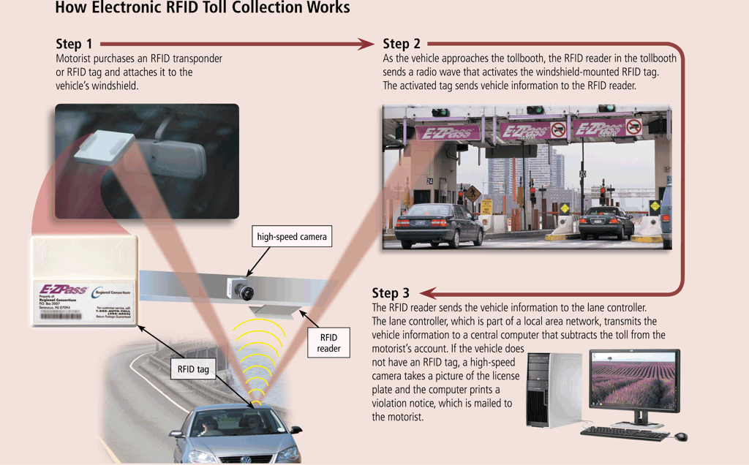
Network Communications Standards

Slide 16
Network Communications Standards
WiMAX (802.16)
Developed by IEEE
Towers can cover a 30-mile radius
Two types are fixed wireless and mobile wireless
Provides wireless broadband Internet access
Wireless Application Protocol (WAP)
Specifies how some mobile devices can display the content of Internet services
Web
E-mail
Chat rooms
Uses a client/server network

Slide 17
The Journey On the Superhighway So Far…Communications Medium
Learned about concepts of communications and networking
They are like blueprints or pipelines
Actually need physical components to join them all together..

Slide 18
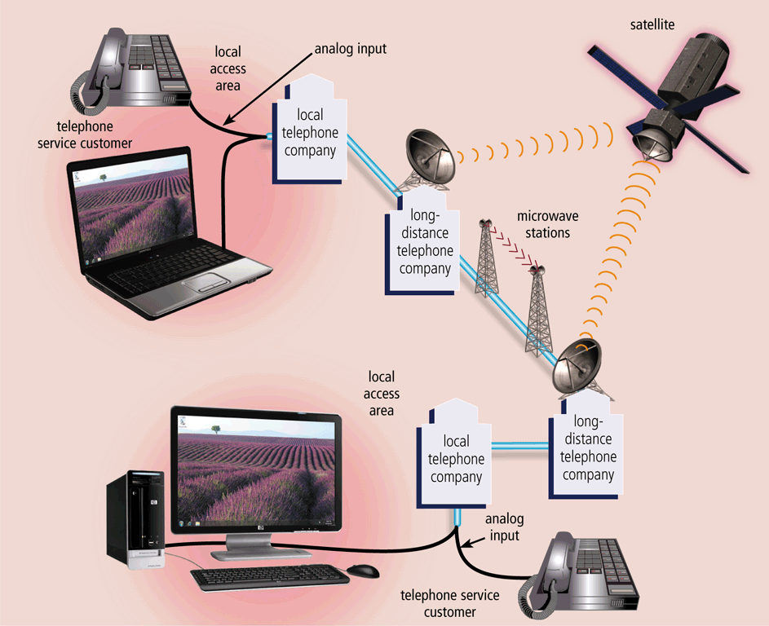
Communications Over the Telephone Network
The public switched telephone network (PSTN) is the worldwide telephone system

Slide 19
Communications Over the Telephone Network
Dial-up lines
Dedicated line
ISDN line
DSL
FTTP
T-carrier line
ATM

Slide 20
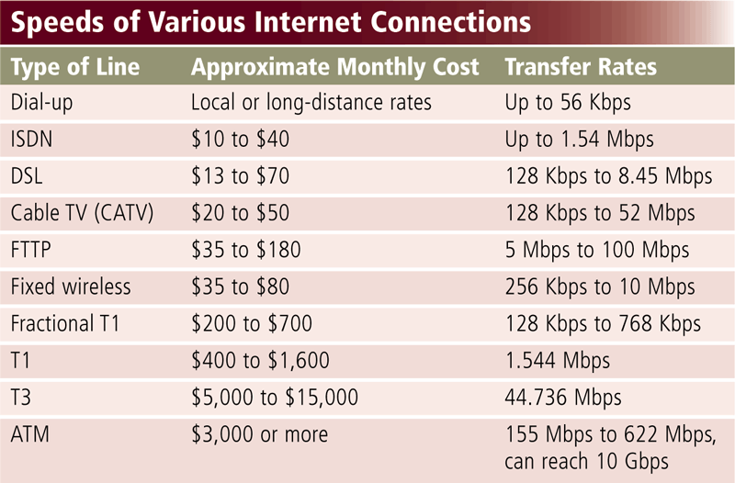
Communications Over the Telephone Network

Slide 21
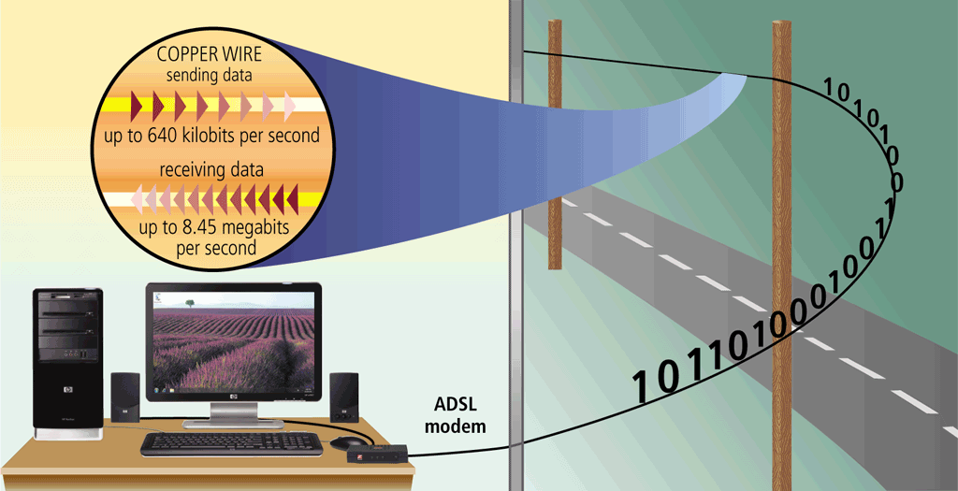
Communications Over the Telephone Network
ADSL connections transmit data downstream at a much faster rate than upstream

Slide 22
Communications Devices
A communications device is any type of hardware capable of transmitting data, instructions, and information between a sending device and a receiving device
A dial-up modem converts signals between analog and digital

Slide 23
Communications Devices
A digital modem sends and receives data and information to and from a digital line
DSL modem
Cable modem

Slide 24
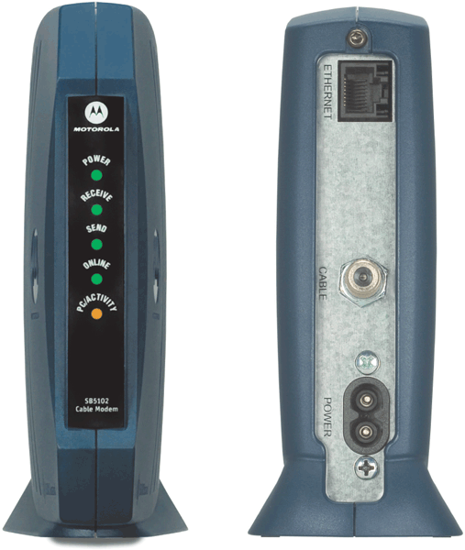
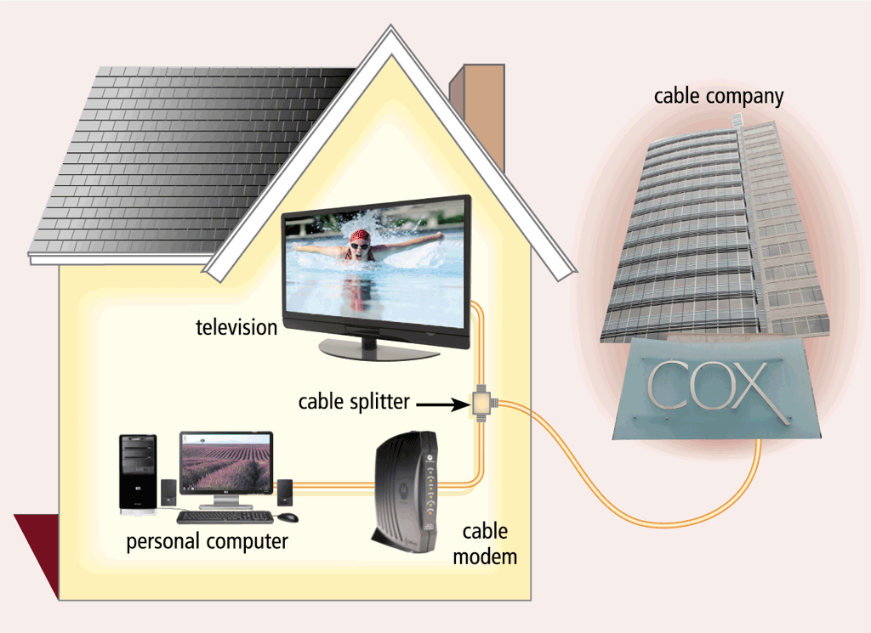
Communications Devices

Slide 25
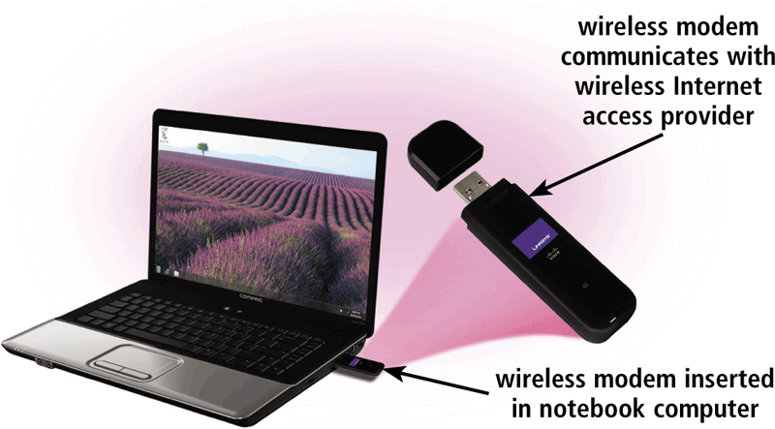
Communications Devices
A wireless modem uses the cell phone network to connect to the Internet wirelessly from a notebook computer, a smart phone, or other mobile device

Slide 26
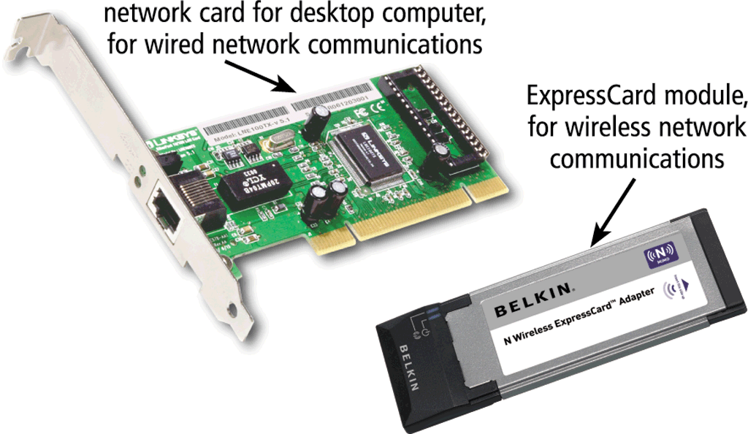
Communications Devices
A network card enables a computer or device to access a network
Available in a variety of styles
Wireless network cards often have an antenna

Slide 27

Communications Devices
A wireless access point is a central communications device that allows computers and devices to transfer data wirelessly among themselves or to a wired network

Slide 28
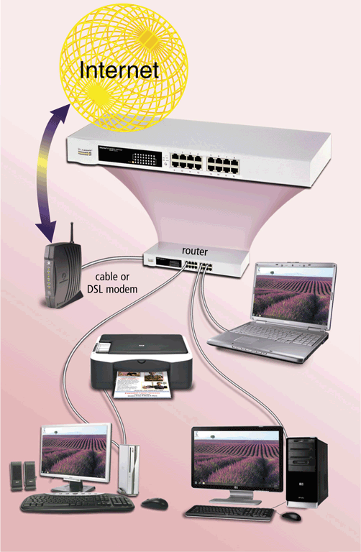
Communications Devices
A router connects multiple computers or other routers together and transmits data to its correct destination on a network
Many are protected by a hardware firewall

Slide 29
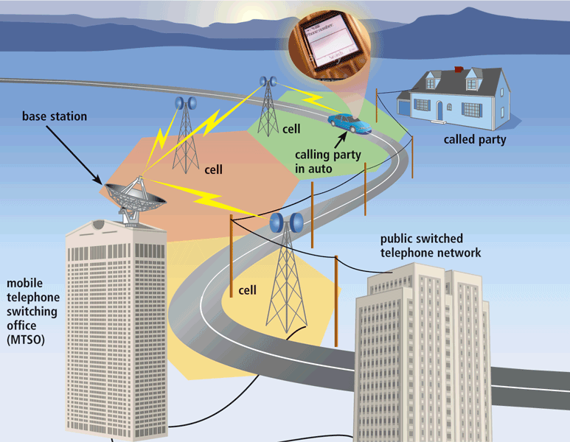
Wireless Transmission Media
Cellular radio is a form of broadcast radio that is used widely for mobile communications

Slide 30
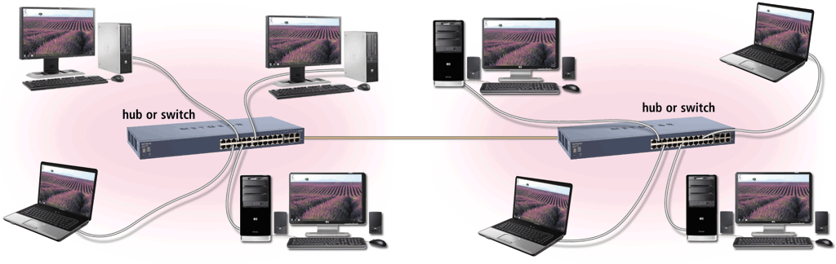
Communications Devices
A hub or switch connects several devices in a network together
Pages 488 – 489
Figure 9-32

Slide 31
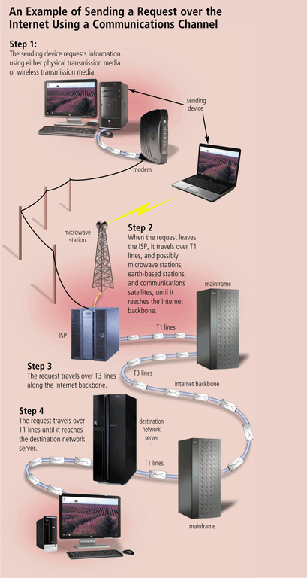
Communications Channel
The amount of data that can travel over a communications channel sometimes is called the bandwidth
Latency is the time it takes a signal to travel from one location to another on a network
Transmission media carries one or more signals
Broadband media transmit multiple signals simultaneously

Slide 32
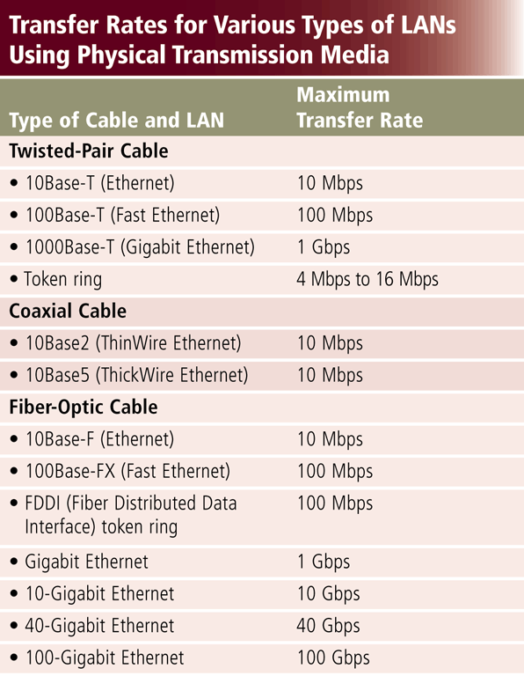
Physical Transmission Media

Slide 33
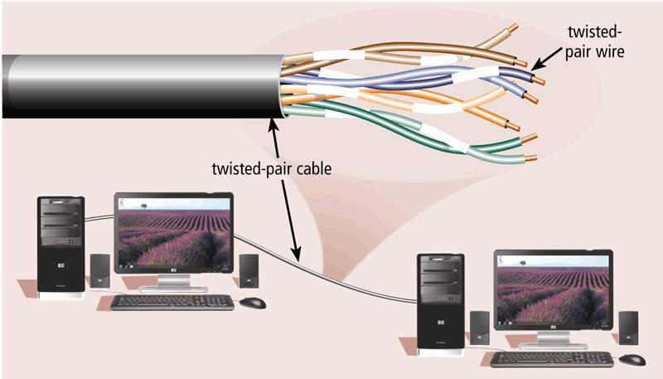
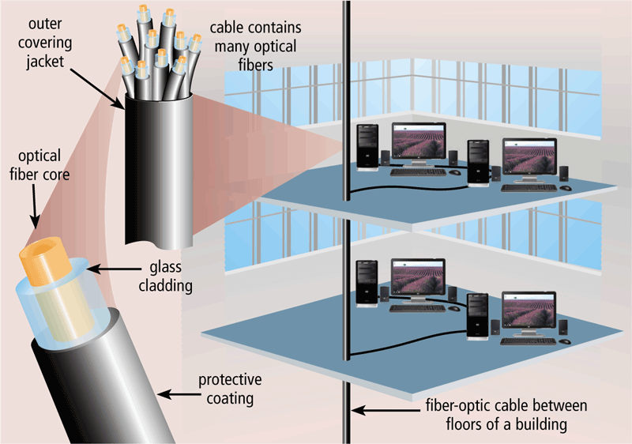
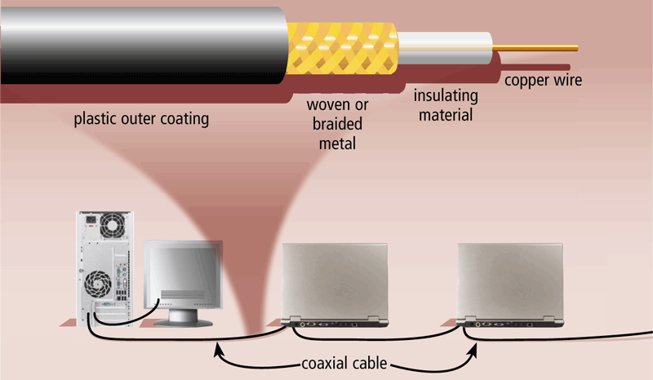
Physical Transmission Media
Twisted-pair cable
Fiber-optic cable
Coaxial cable

Slide 34
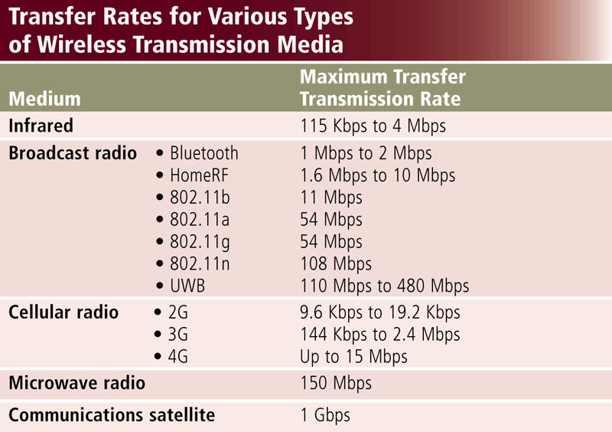
Wireless Transmission Media

Slide 35
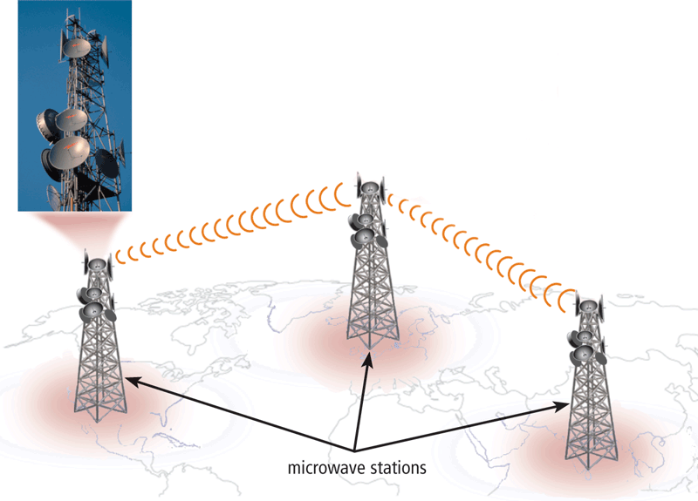
Wireless Transmission Media
Microwaves are radio waves that provide a high-speed signal transmission

Slide 36
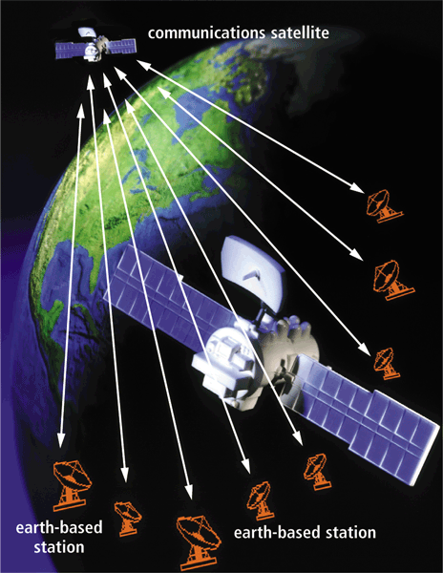
Wireless Transmission Media
A communications satellite is a space station that receives microwave signals from an earth-based station, amplifies it, and broadcasts the signal over a wide area

Slide 37
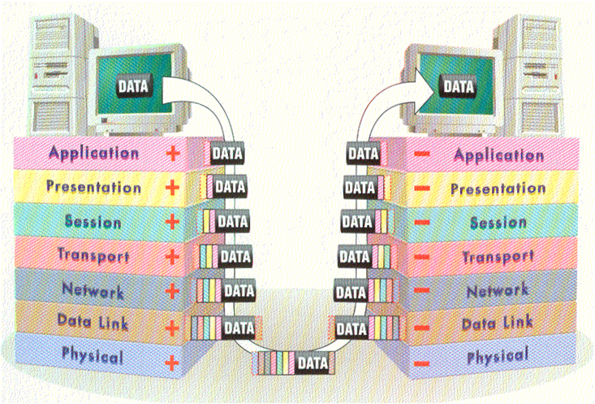
Putting Them Together in Layers

Slide 38
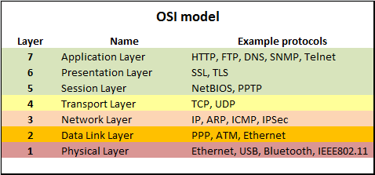
Putting Them Together in Layers
OSI – Open System Interconnection Model
Define the networking framework to implement protocols in seven layers
http://www.webopedia.com/quick_ref/OSI_Layers.asp

Slide 39
How to remember OSI layers?
[Application] Away [Presentation] Pizza [Session] Sausage [Transport] Throw [Network] Not [Data Link] Do [Physical] Please

Slide 40
Conclusion
We have concluded our learning about networks and communications
As you can see, the WWW/Internet involves different communication technologies, network technologies and devices
But they work together because of standard way of talking to each other called protocols and you will learn more in the days ahead

Slide 41
Conclusions
We have learned another “nut” and “bolt” of the Internet and WWW
You will learn more in the future as you progress in this diploma and learn really how to build and configure networks of the future

Slide 42
Fun Quiz
Play Kahoot Game:
https://kahoot.it/
Enter NickName: 1_XXX
( for group 1 students)
XXX is your admin number

